Slide 1
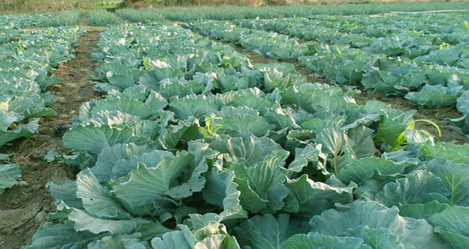
NORTH WEST DEPARTMENT OF AGRICULTURE AND RURAL DEVELOPMENT AGRICULTURAL SUPPORT SERVICES
Presentation title: Pests and diseases affecting cabbages
M. Mtileni
Crop Science
Research and Technology Development
Dr KK District
Presenter’s contact details: mmtileni@nwpg.gov.za
018 299 6503/072 266 4276
Date: June 2021

Slide 2
Introduction
Various pests and diseases attack cabbage, and this can lead to serious economic loss.
Generally speaking, integrated pest management strategies, including scouting, crop rotation, good crop management, chemical and mechanical control of pests and diseases can be used for control.

Slide 3
Pests affecting cabbage
Cabbage aphids are gray-green but usually appear gray or white due to a dusty, waxy secretion that covers their bodies.
Aphids suck the leaves of the plants and cause serious damage to the plants.
They cause wrinkled, downward-curling leaves, yellow leaves, and reduced growth.
Cabbage aphids prefer young plant tissue—they are often found in growing

Slide 4
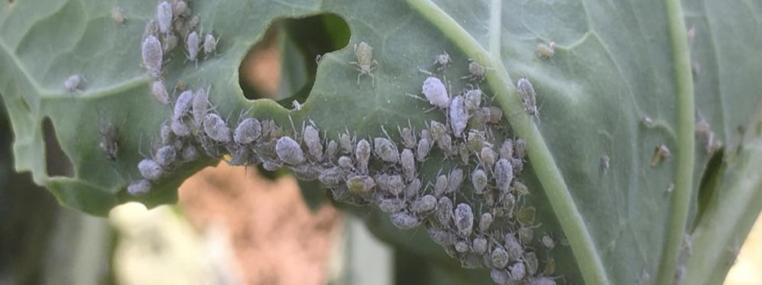

Slide 5
Aphids management in Cabbage
Incorporate crop residues immediately. before eggs hatch.
Control brassica weeds in and around fields.
Inspect transplants before planting to ensure that they are not infested.
Rogue out infested plants early in the season.
Non-winged cabbage aphids are not very mobile, so it is common to find one severely infested plant surrounded by totally clean plants.
Use reflective mulches to deter aphids.

Slide 6
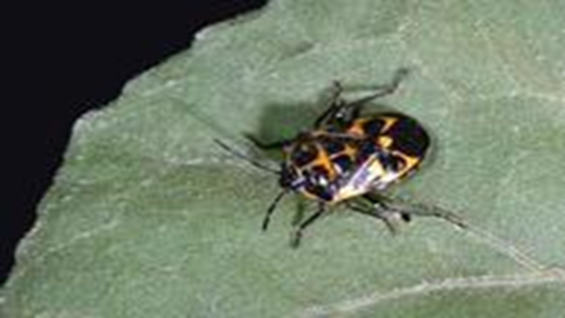
The Bagrada bug
The Bagrada bug, also called the painted bug, is a stink bug that attacks various vegetable crops including cabbage.
Bagrada bugs suck sap from the leaves of the plants, and it can damage the growing points of the seedlings, causing the cabbage to make several small unmarketable heads.

Slide 7
Bagrada bug management in Cabbage
In gardens where the Bagrada bug is present in very high densities, it may be advisable to remove very attractive host plants.
Removal of plant residue after harvest can reduce carryover between crops.
Picking the bugs off plants by hand is only feasible if pest populations are very low.

Slide 8
Diamond back moth
The small greenish larvae eat window-like holes in cabbage leaves, damage the growing points and may cause serious damage to the crop.
The caterpillar is a surface feeder.
They feed from the lower leaf surface, leaving the wax layer on the upper surface intact, thereby creating translucent windows.
In cases of severe infestation, entire leaves may be destroyed, leaving only the veins

Slide 10
Diamond back moth management in Cabbage
Growers must check their seedlings, young plants and growing plants regularly (scouting).
Because DBM has a narrow host range, feeding exclusively on cruciferous plants, crop rotation away from a host plant can significantly reduce the number of pests and subsequent damage in cropping systems.

Slide 11
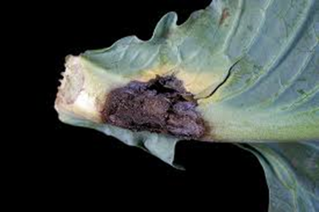
Diseases affecting cabbage
Black rot
Black rot is caused by Xanthomonas campestris pv. campestris. The leaf edges turn yellow-brown and dry out, and the veins turn black. When cut open, the xylem (woody area of stem) shows blackening.

Slide 12
Black rot management in Cabbage
No treatment is effective if the plants are already infected.
Remove infected plants immediately and destroy them.
Plant disease-free seed
Crop rotation.
Apply field sanitation Plant resistant cultivars

Slide 13
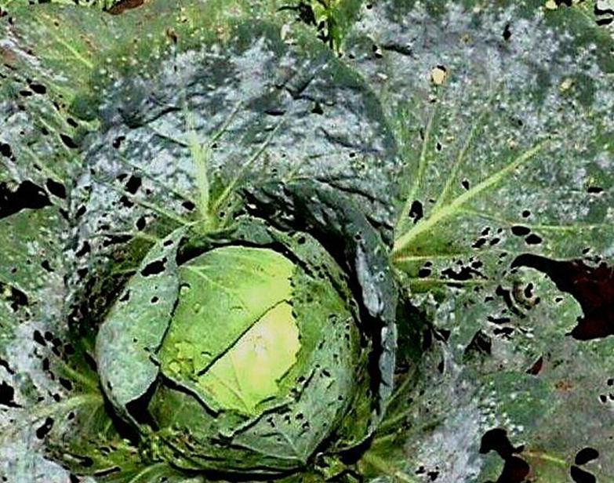
Downy mildew
Downy mildew is Caused by Peronospora parasitica, the downy mildew fungus can live in the soil until the next crop.
Symptoms included Pepperspot lesions are present on the upper leaf surface, with white growth present on the lower leaf surface.

Slide 14
Downy mildew management in Cabbage
Chemical control
Plant disease-free seedlings
Don’t over-irrigate

Slide 15
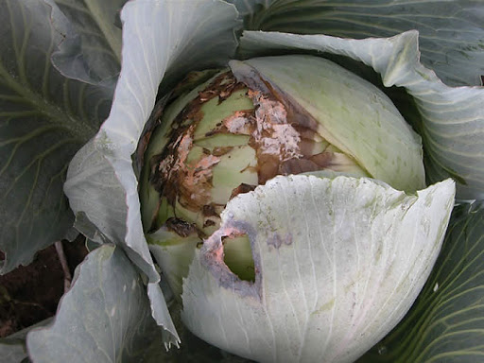
White rot
White rot White fluffy growth is present on leaves and stems causing rot and wilting of plants, and is caused by Sclerotinia sclerotiorum

Slide 16
White rot management in Cabbage
Plant disease-free healthy seed.
Chemical control works but nothing registered in S. Africa.
Control weeds around field.
Crop rotation.
Don’t over-irrigate.
Avoid planting cabbage in fields that are surrounded by dense woods that will restrict air circulation and subsequently delay drying

Slide 17
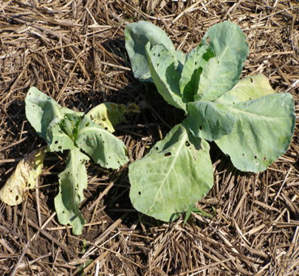
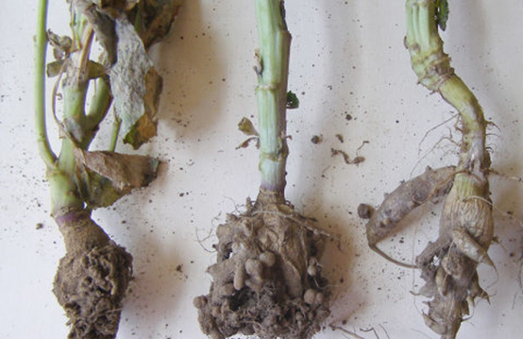
Club root
Club root is caused by Plasmodiophora brassicae. Plants are stunted and yellow, with large swellings on the roots.

Slide 18
club root management in Cabbage
Plant disease-free seedlings.
Long crop rotation (7 years) Add lime if soil is acidic.
Control weeds around planting.

Slide 19
THANK YOU

