Slide 1
NORTH WEST DEPARTMENT OF AGRICULTURE AND RURALDEVELOPMENT AGRICULTURAL SUPPORT SERVICES
RECORD KEEPING
ZC Raphalalni
Letlhakaneng Community Hall
zraphalalani@nwpg.gov.za
018 299 6500
2021/09/30

Slide 2
Introduction
To keep records is simply to collect relevant information that can help you to take good decisions and to keep track of activities
Records can be about any performance of the animals
It is important to keep record keeping simple, and quick to interpret.
And then they can be supplemented with remarks in a record book which can explain some unusual events or findings

Slide 3
Records can be used for what
keep your memory
decision making
To keep track of all animals (Identification records)
Evaluation of livestock for selection (breeding records; financial records; production records)
Aids in disease management;(disease records)
To assess profitability/losses (financial records)

Slide 4
Identification Records
An identification method should be cheap, not harming the animal, reliable to read at a distance, (Act No. 6 of 2002).
Identification of animals is usually through use of numbering, by marking of the animal
3. Method of Identification
Tattooing (ear or under)
Brand (Hot iron, The height of the letters=40-100mm and space between letters is 12.5 mm
Ear-notching, Punching
Tags (Ear-tags, permanent if they do not fall off)

Slide 5
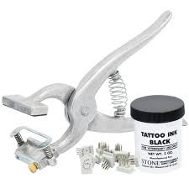
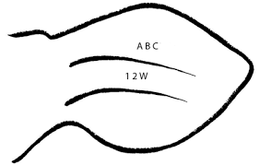

Slide 6
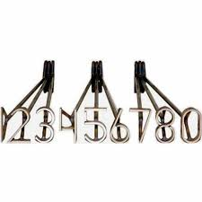
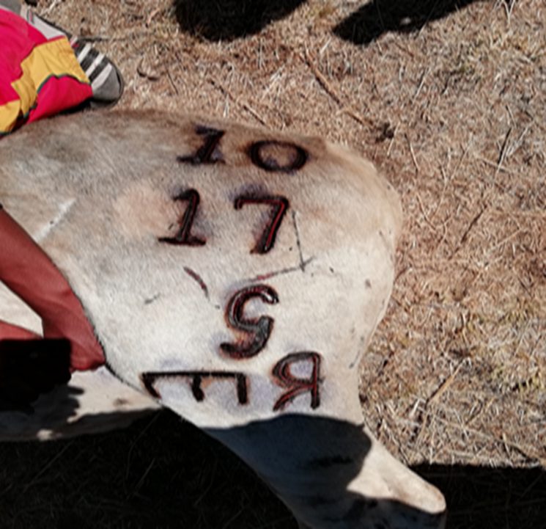
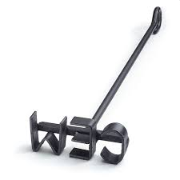

Slide 7
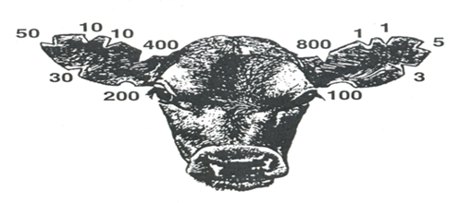
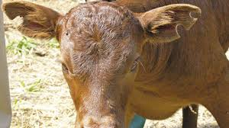
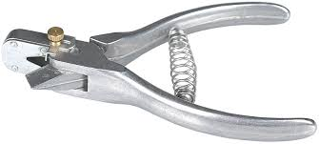

Slide 8
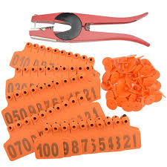
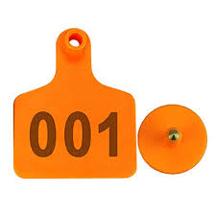
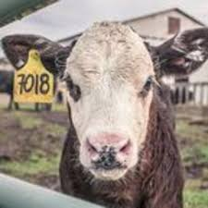

Slide 9
CALF BIRTH AND WEAN PERFORMANCE RECORDING

Slide 11
